Slide 1
Construct New Nursing Home and Domiciliary
CDB Project No. 040-010-115
November 19, 2019

Slide 2
Introductions
Brent Lance
Administrator of Capital Planning /QBS
Chris MacGibbon
Project Manager
Melissa Porter
Project Manager
Capital Development Board

Slide 3
Introductions
Gwen Diehl
Capital Programs Administrator
Troy Culbertson
Administrator of IVH Quincy
Dave Clifford
Chief Engineer
Department of Veteran’s Affairs

Slide 4
Introductions
Ramu Ramachandran
Project Manager
Perkins Eastman Architects

Slide 5
Phase I Schedule
November 12, 2019 - RFP Issued
November 19, 2019 - Pre-Submittal Meeting
December 4, 2019 – Last Day to Submit Questions
December 11, 2019 – Submittals Due by 2:00PM

Slide 6
2 Phase Selection Process
Phase I – Qualifications
Phase II – Technical & Cost Proposal
Design-Build

Slide 7
Phase I
Proposal Transmittal Form (DB-PTF)
Standard Business Terms and Conditions
Financial Disclosures and Conflicts of Interest
Illinois State Board of Section 1 – General Documents
Joint Venture Agreement (if applicable)
Section 1 – General Documents

Slide 8
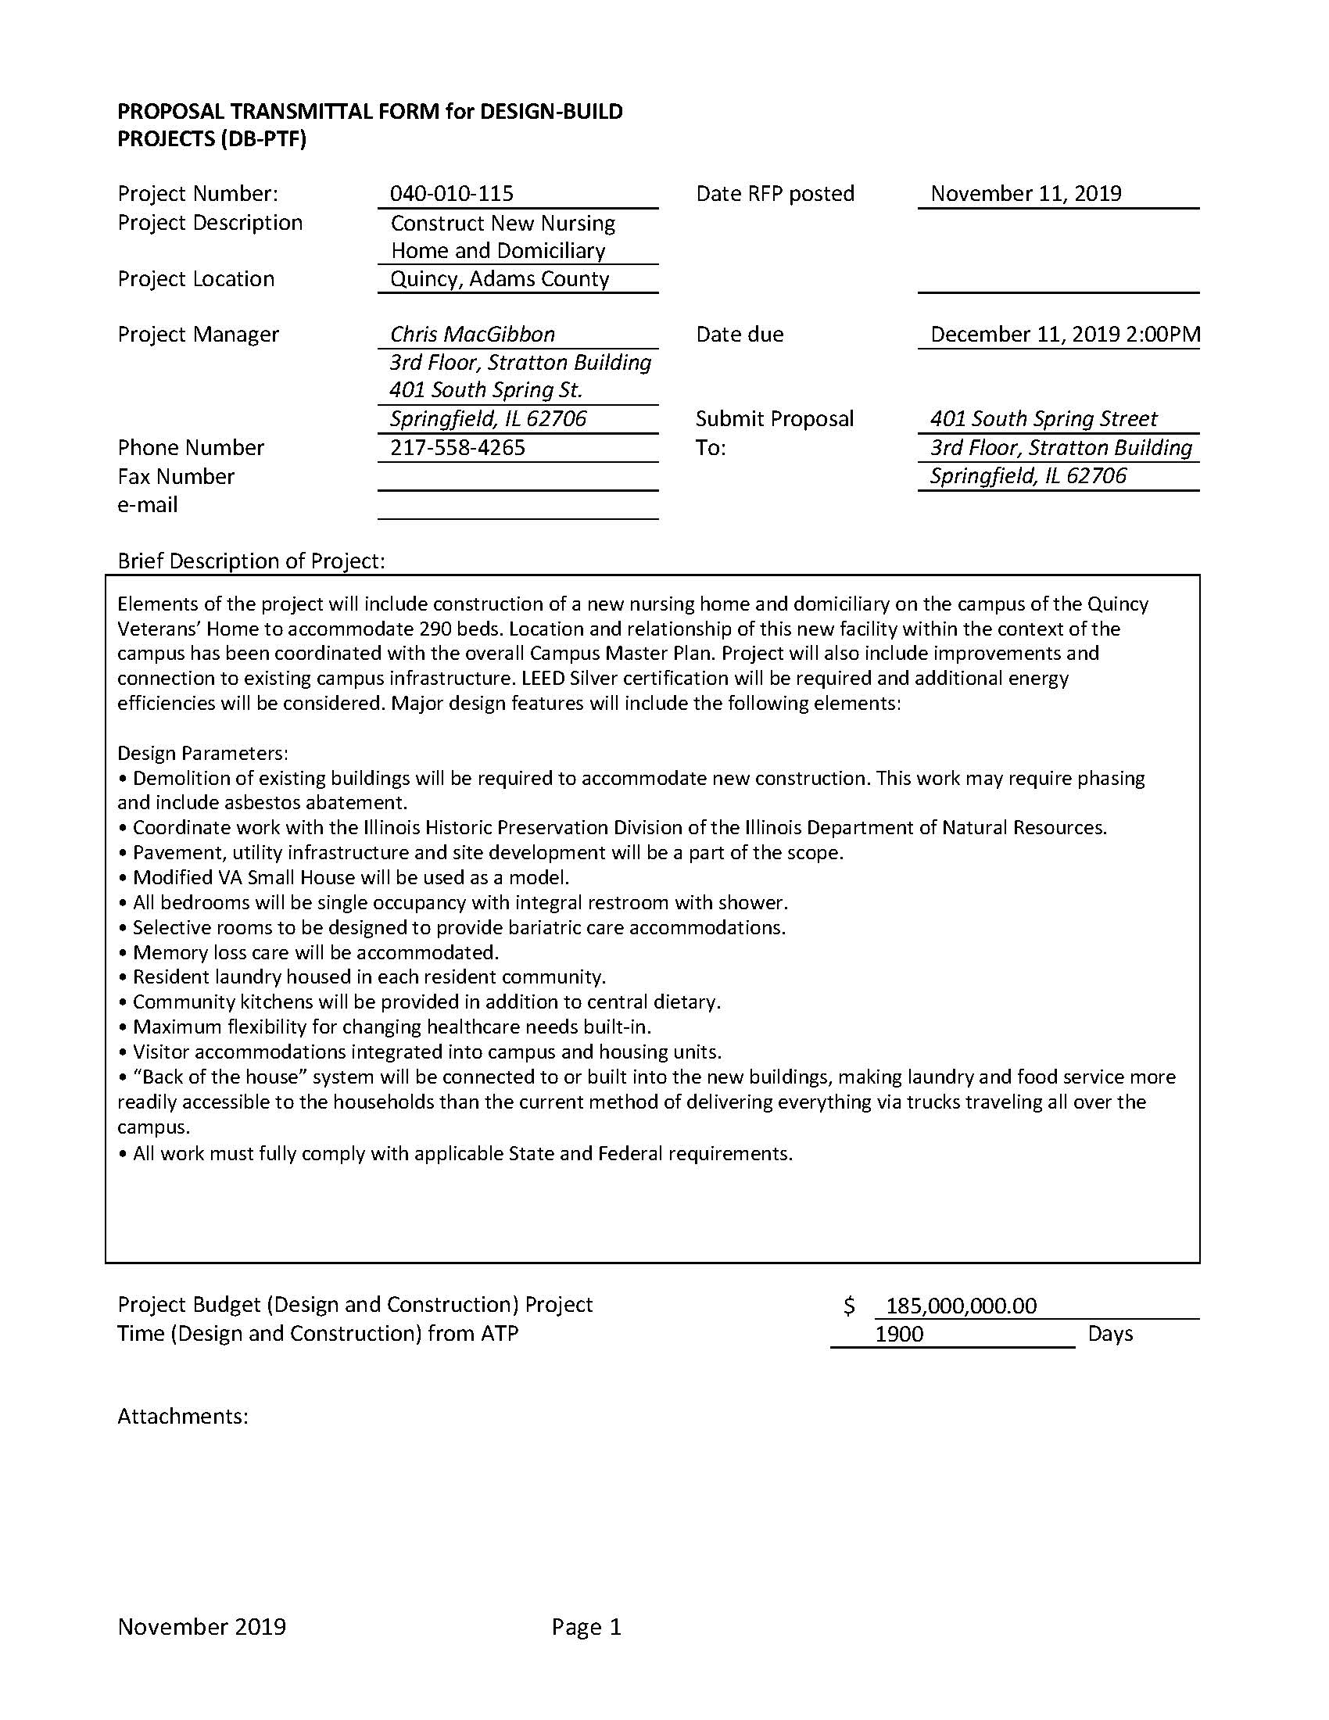
Proposal Transmittal Form (DB-PTF)

Slide 9
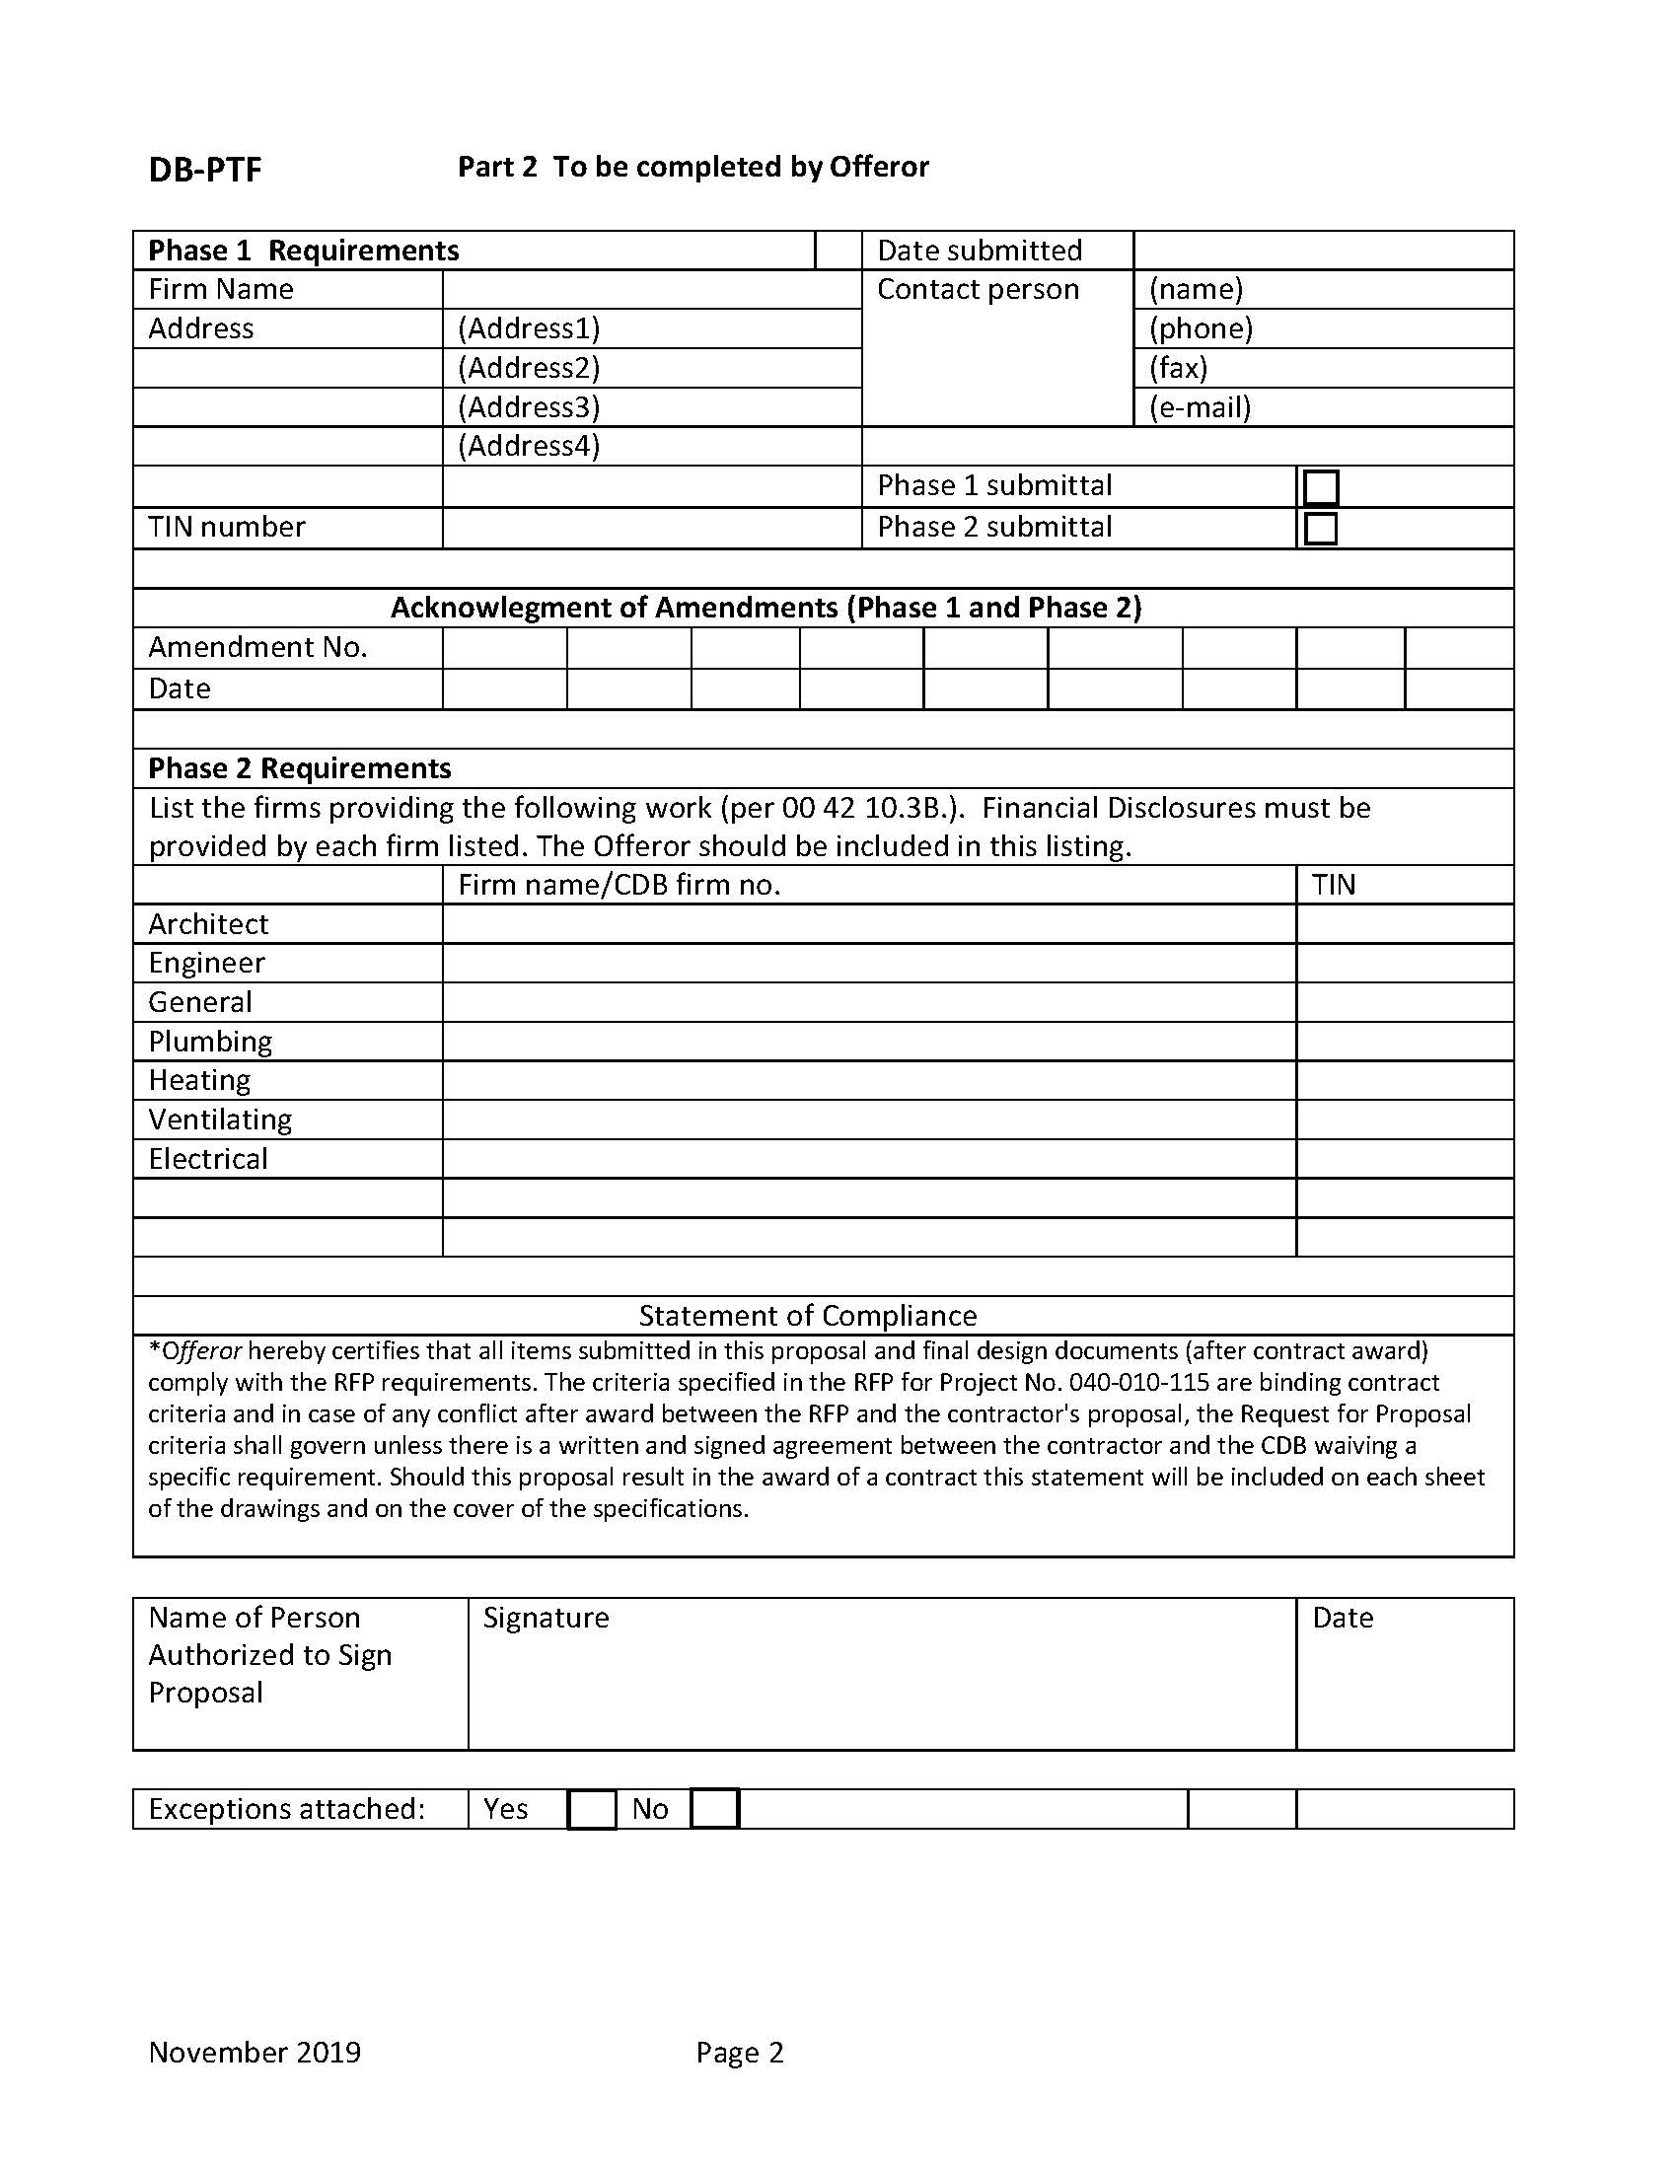
Proposal Transmittal Form (DB-PTF)

Slide 10
Proposal Transmittal Form (DB-PTF)
Form must be signed by someone with the authority to contractually bind the company.
The Offeror must include themselves in the appropriate category (ie., General) on the form.
You must include Standard Terms & Conditions, Board of Elections Certificates, and Financial Disclosures and Conflicts of Interests documents for every firm identified on the DB-PTF.
  Failure to include the Financial Disclosures and Conflicts of Interest is a Material Deficiency and will result in rejection.

Slide 11
Phase I
Design-Build Entity Qualifications Form (DBQ)
Past Performance Evaluation Questionnaire
Past Performance MBE/WBE/VBE Phase I Utilization Plan
Section 2 – Past Performance

Slide 12
Phase I
This section of the submittal is limited to 25 pages of information (excluding the Past Performance Questionnaires).
It includes the Offeror’s DBQ and any discussion and/or additional information, awards, letters, etc. concerning past performance.
Section 2 – Past Performance

Slide 13
Design-Build Entity Qualifications Statement (DBQ)

Slide 14
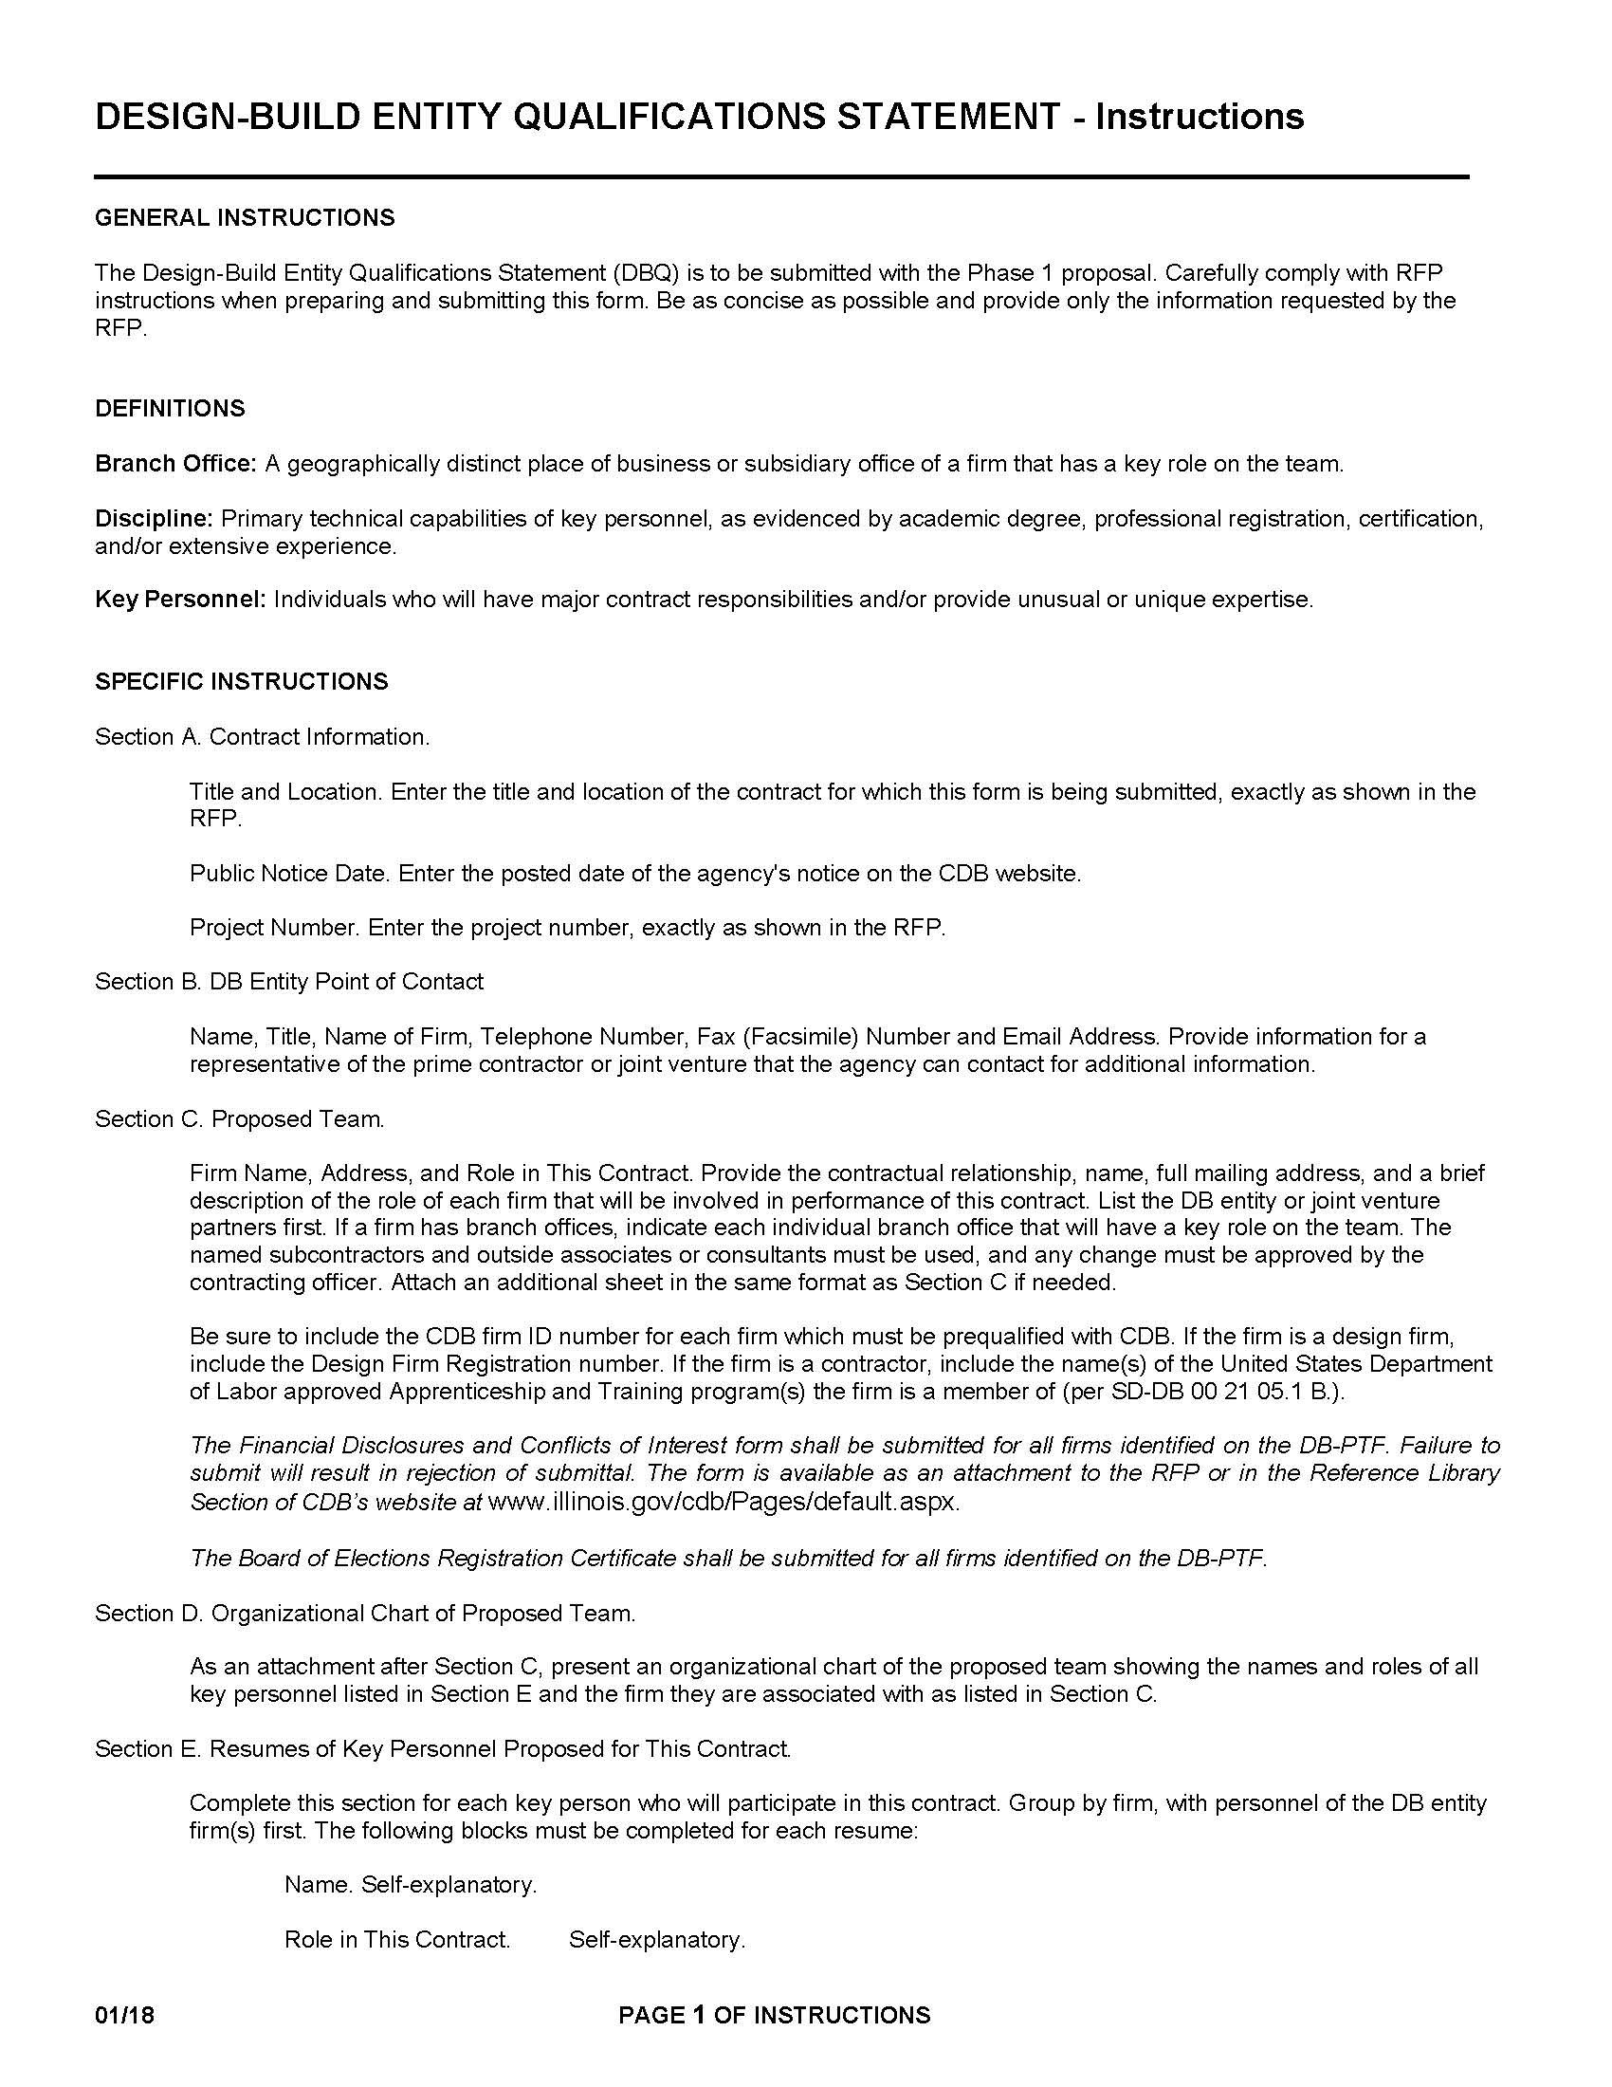
Design-Build Entity Qualifications Statement (DBQ)

Slide 15
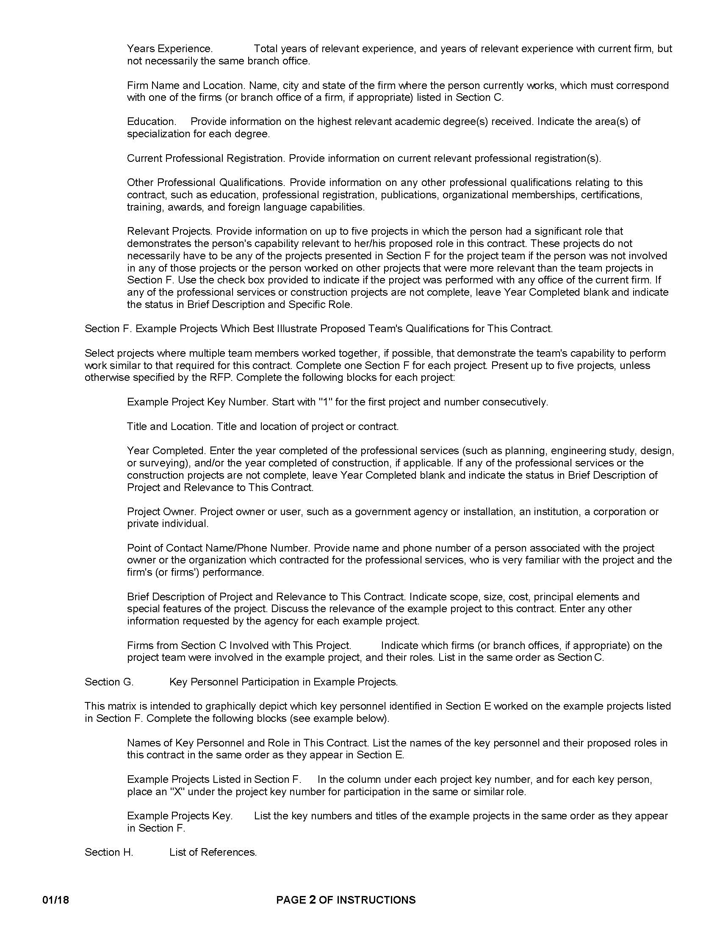
Design-Build Entity Qualifications Statement (DBQ)

Slide 16
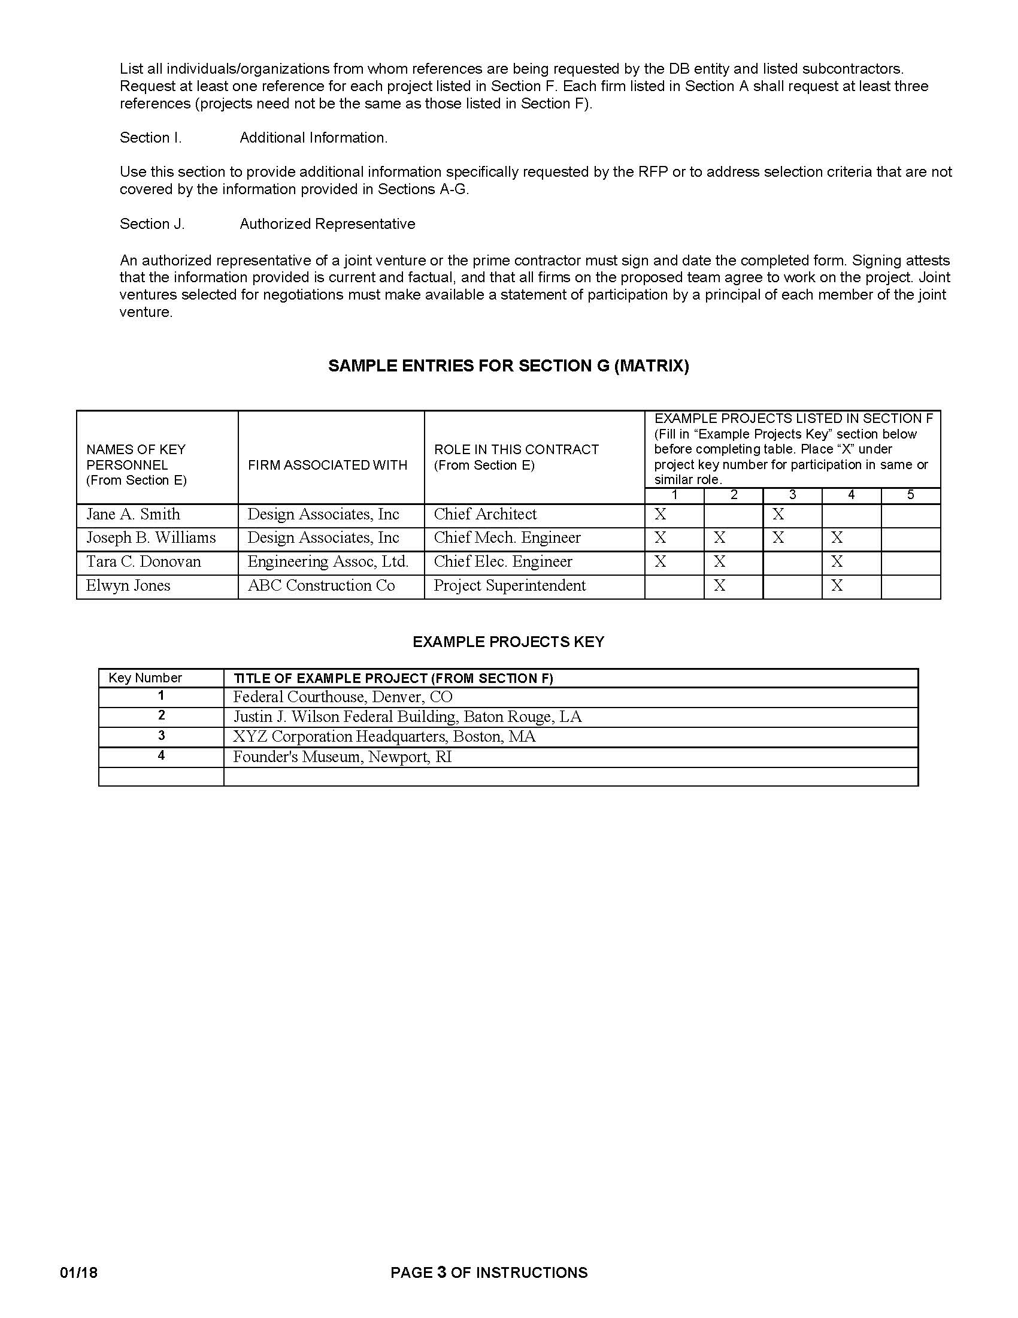
Design-Build Entity Qualifications Statement (DBQ)

Slide 17
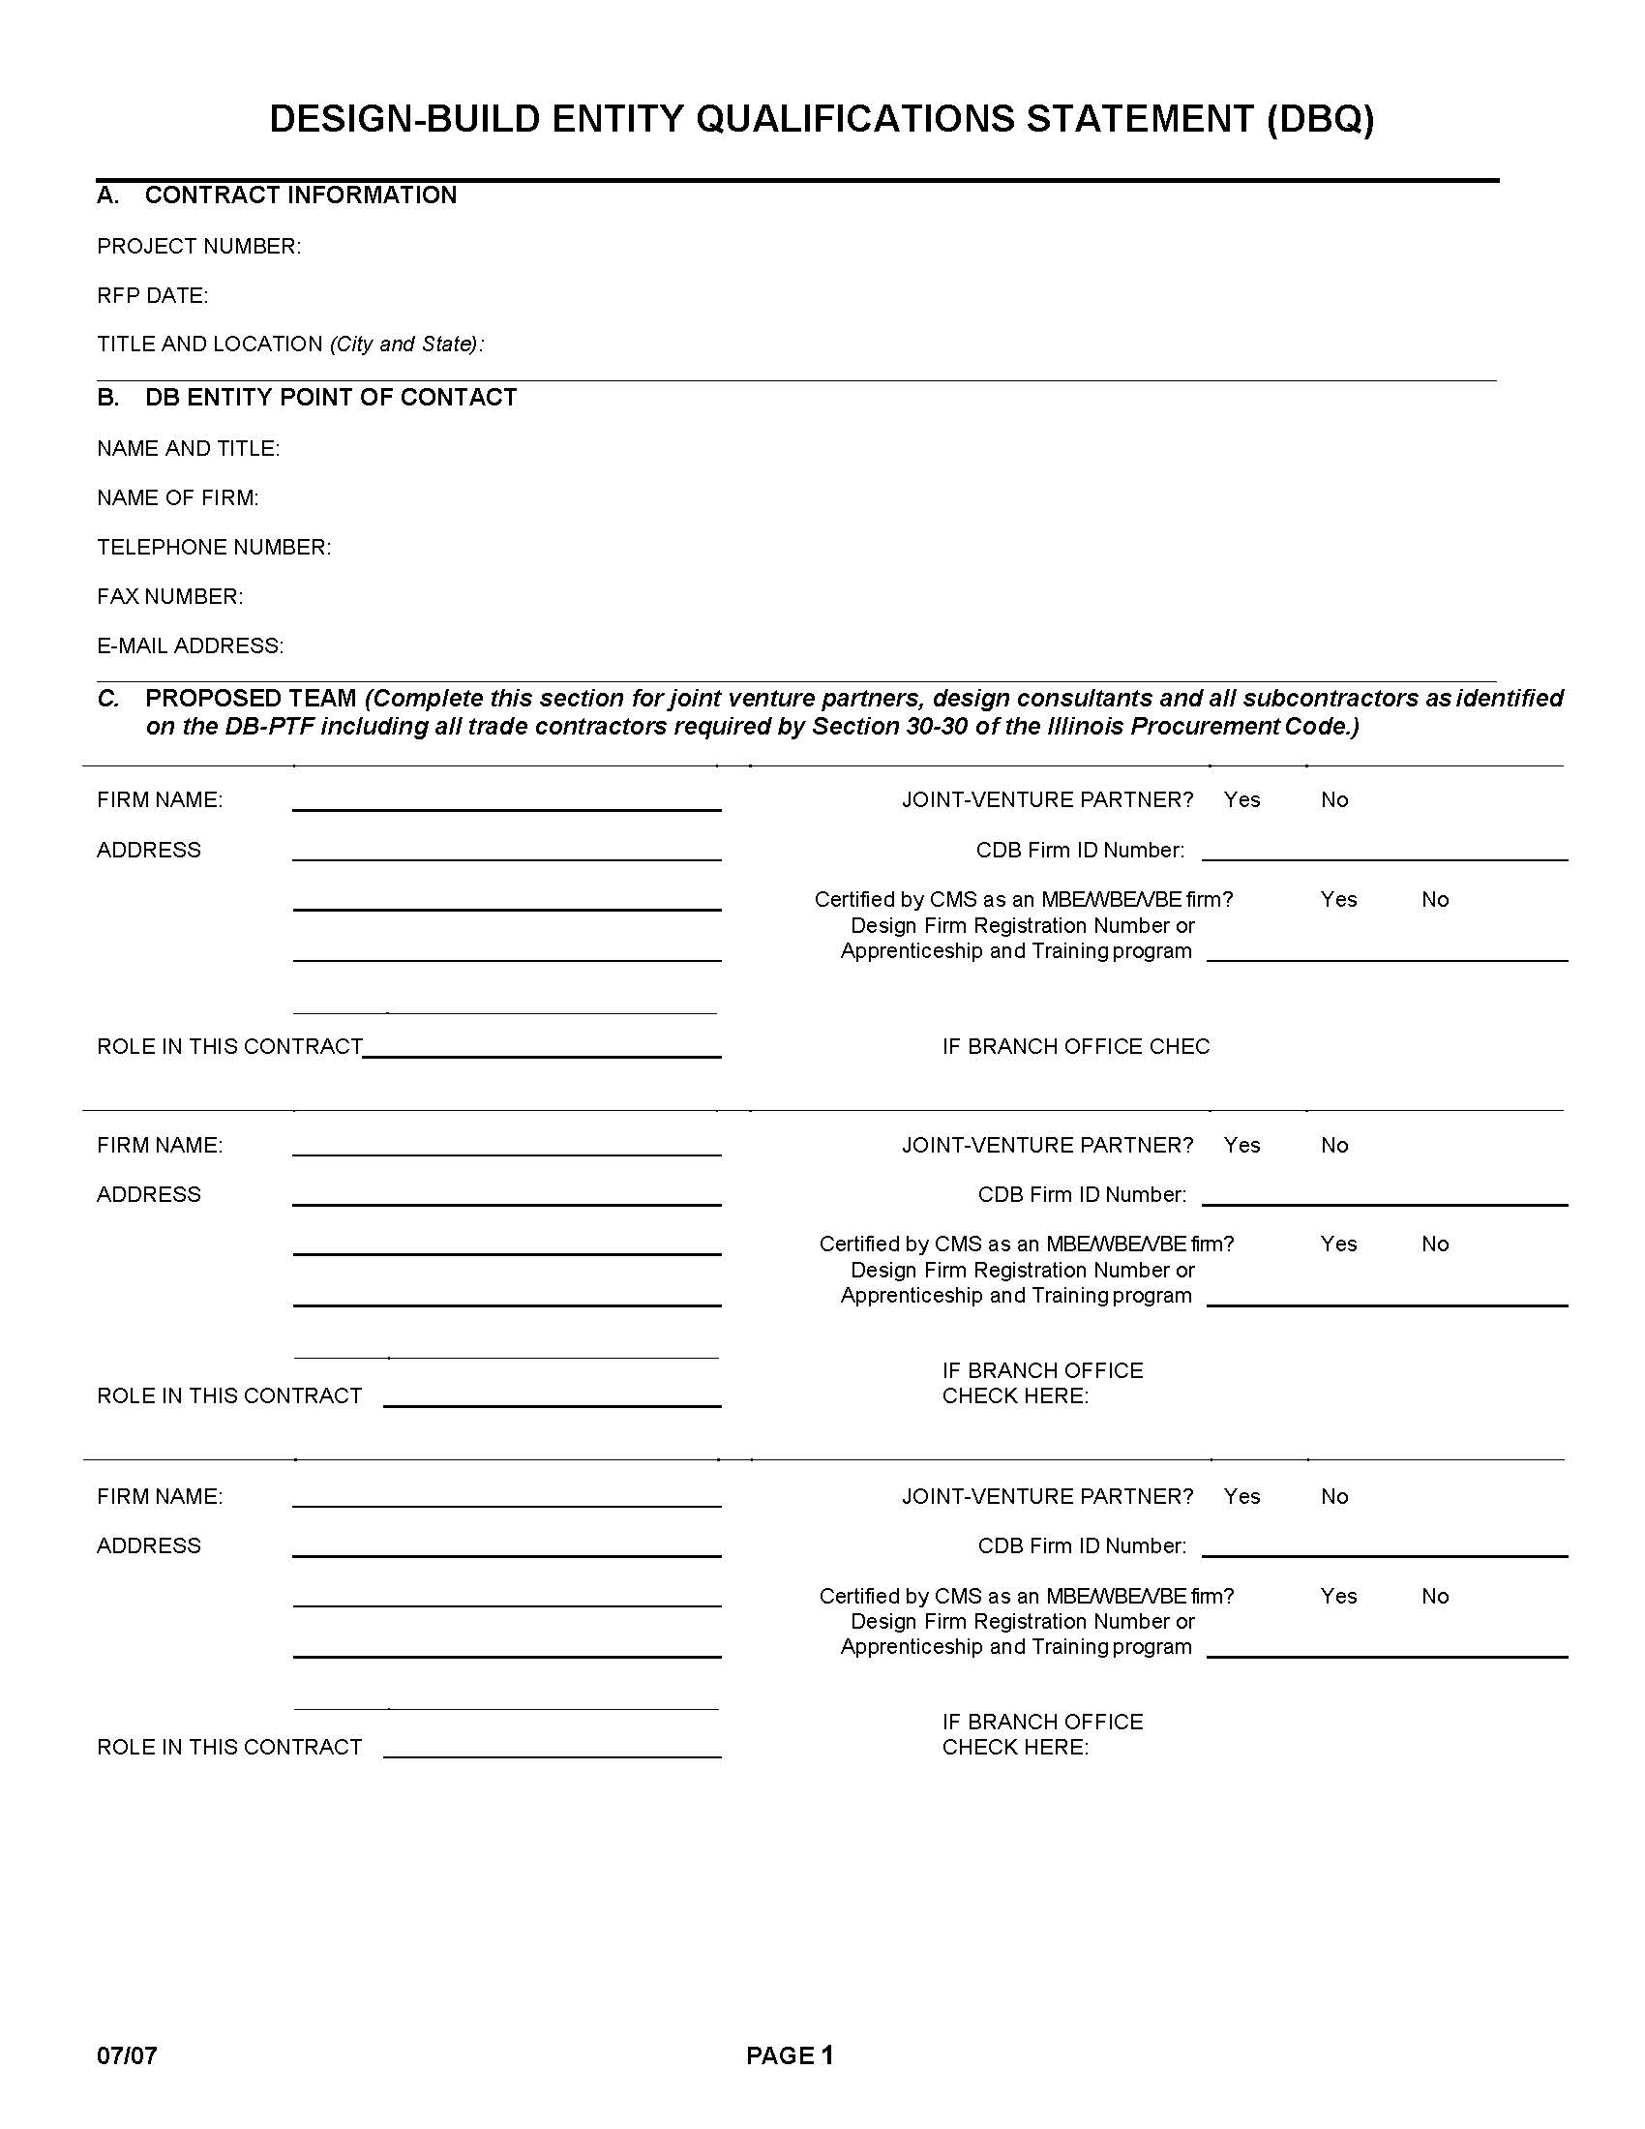
Design-Build Entity Qualifications Statement (DBQ)

Slide 18
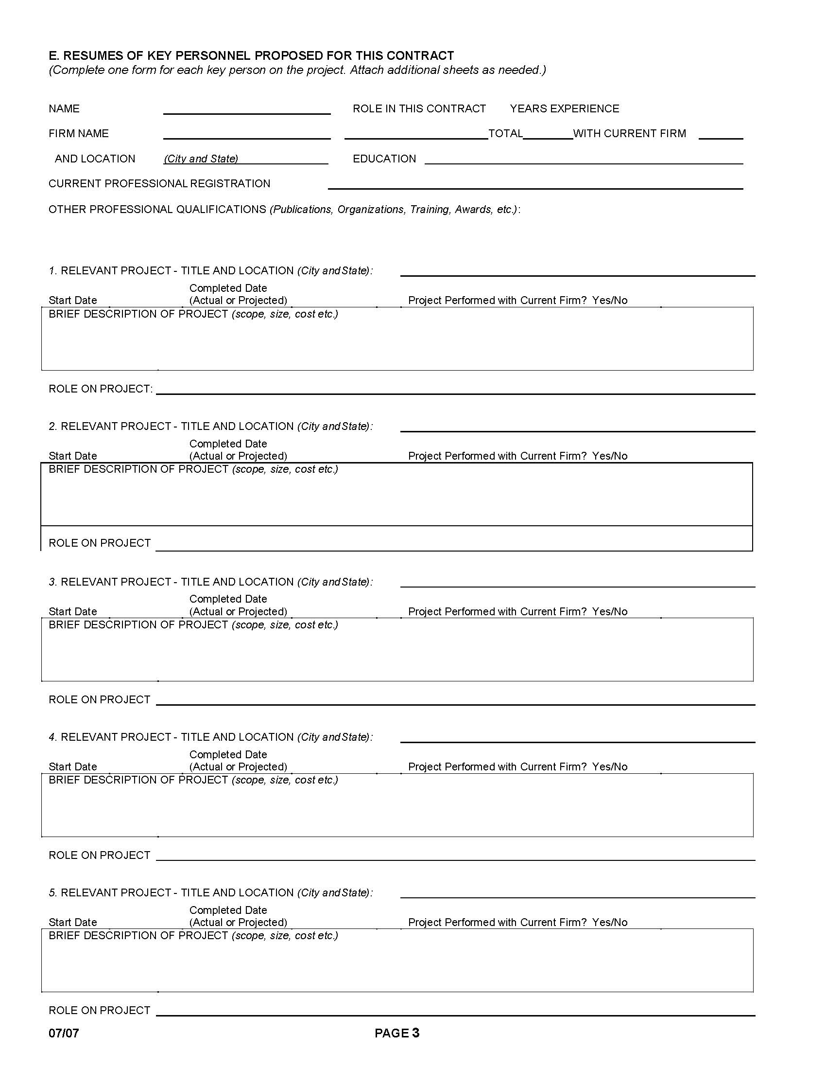
Design-Build Entity Qualifications Statement (DBQ)

Slide 19
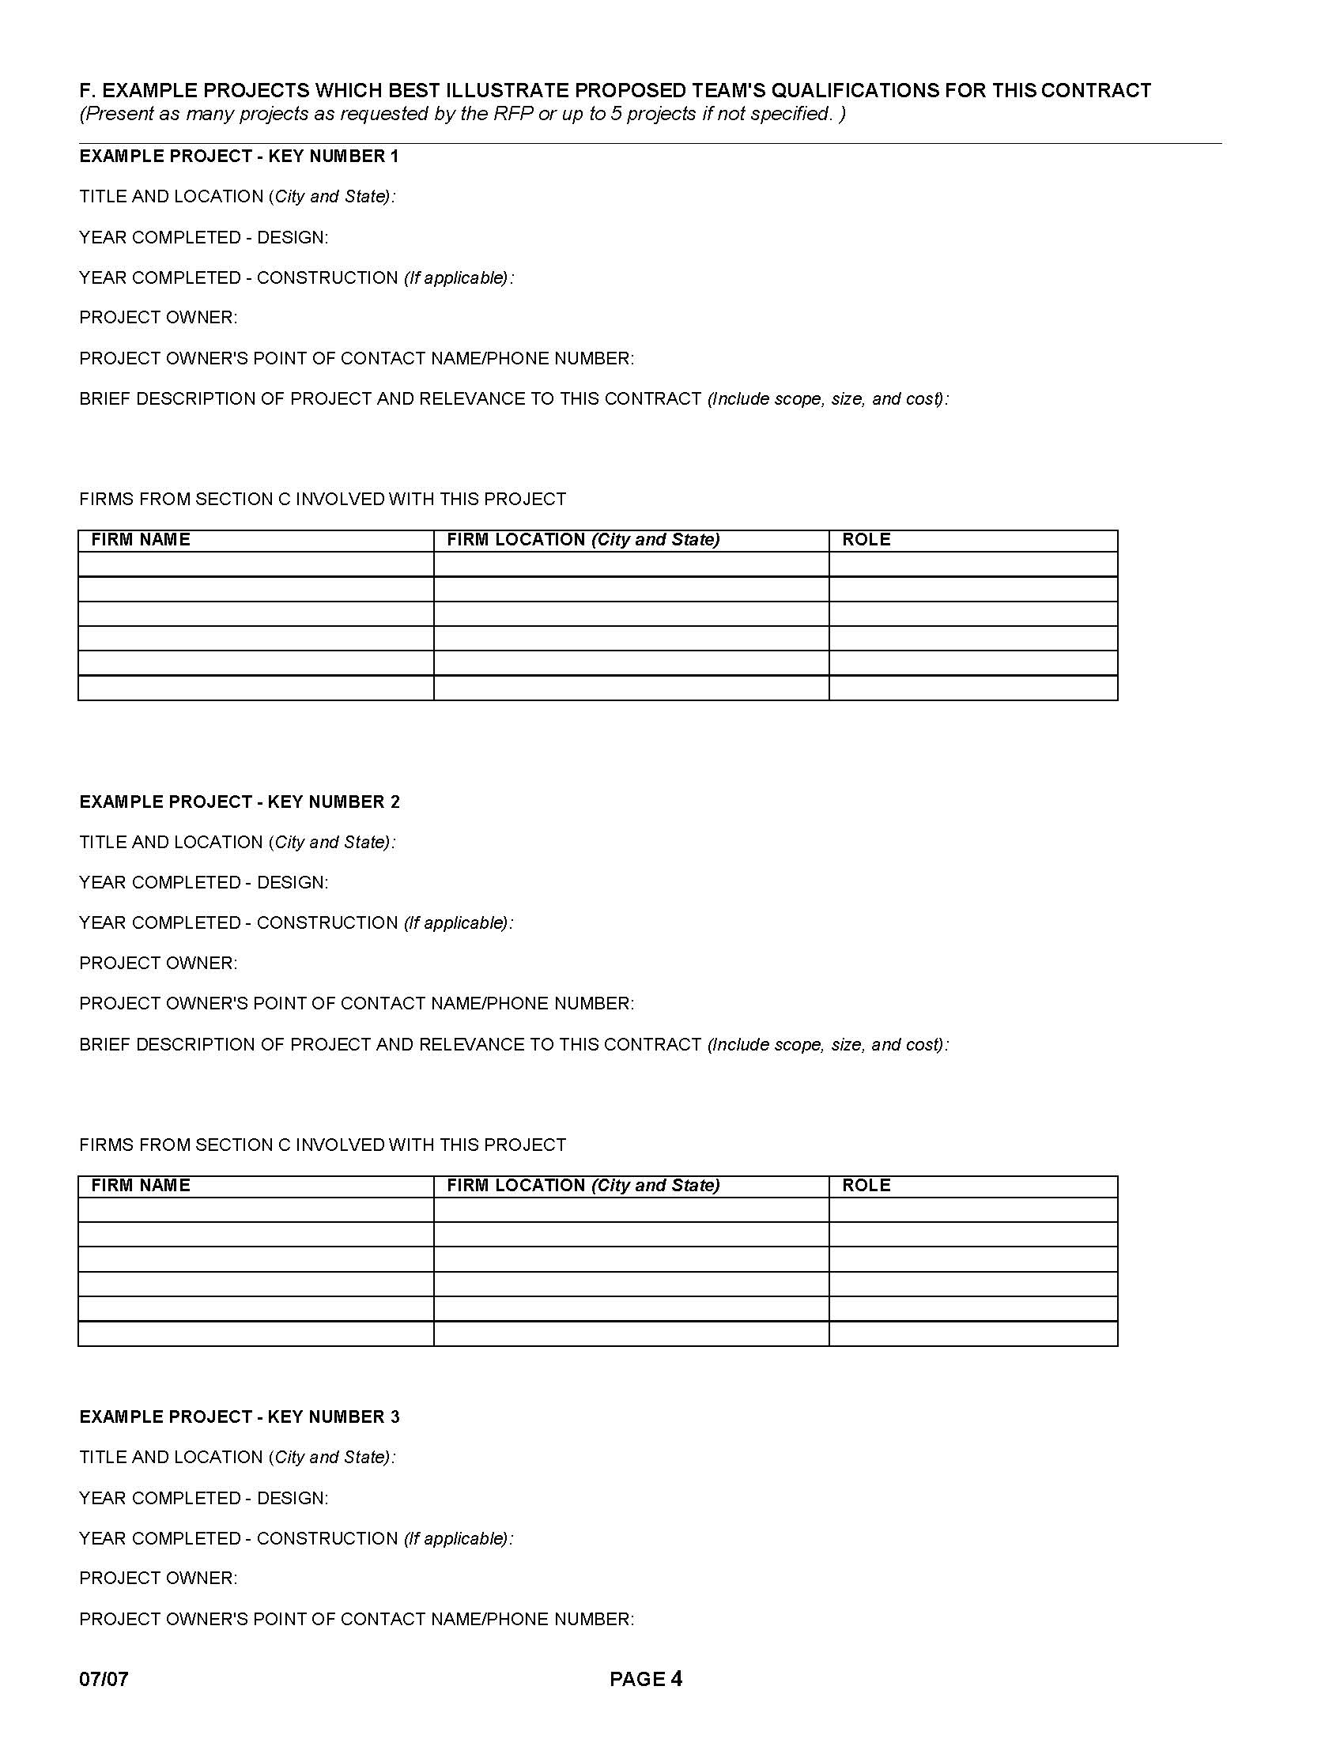
Design-Build Entity Qualifications Statement (DBQ)

Slide 20
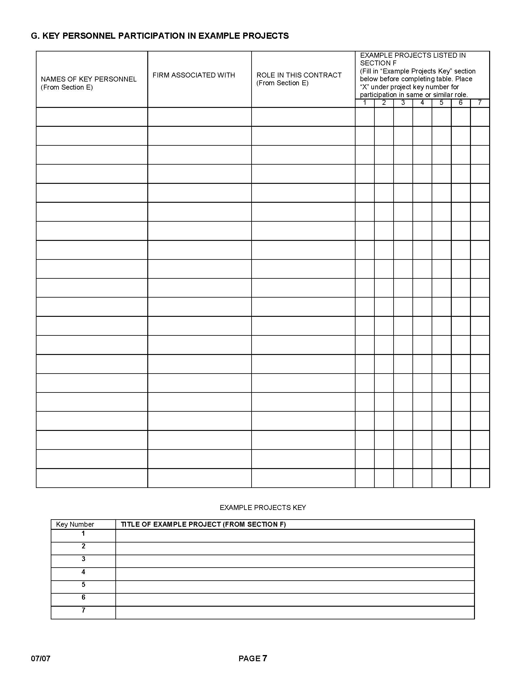
Design-Build Entity Qualifications Statement (DBQ)

Slide 21
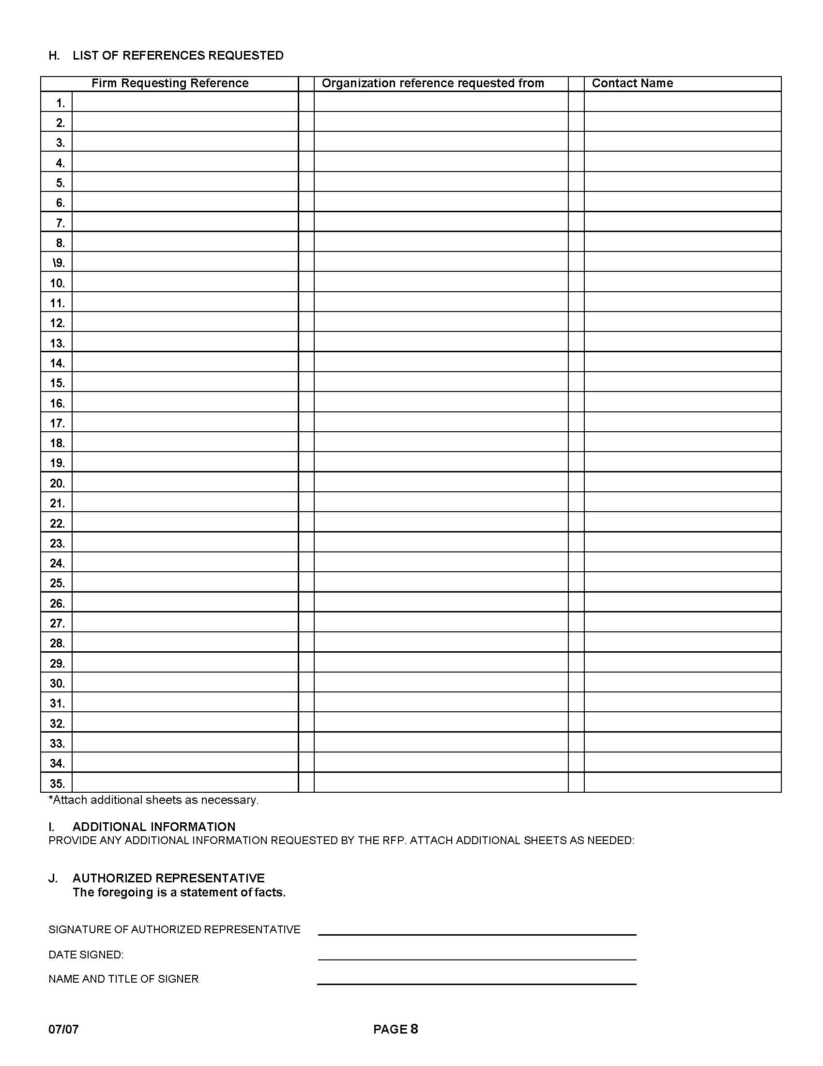
Design-Build Entity Qualifications Statement (DBQ)

Slide 22
Design-Build Entity Qualifications Statement (DBQ)
A minimum of 3 projects must reflect the experience of the Offeror.
A minimum of 2 projects must reflect the experience of the Design Team.
A minimum of 5 contracts must be represented (maximum of 7).
Failure to submit the required information is a MATERIAL DEFICIENCY.

Slide 23
Reference Questionnaire Package

Slide 24
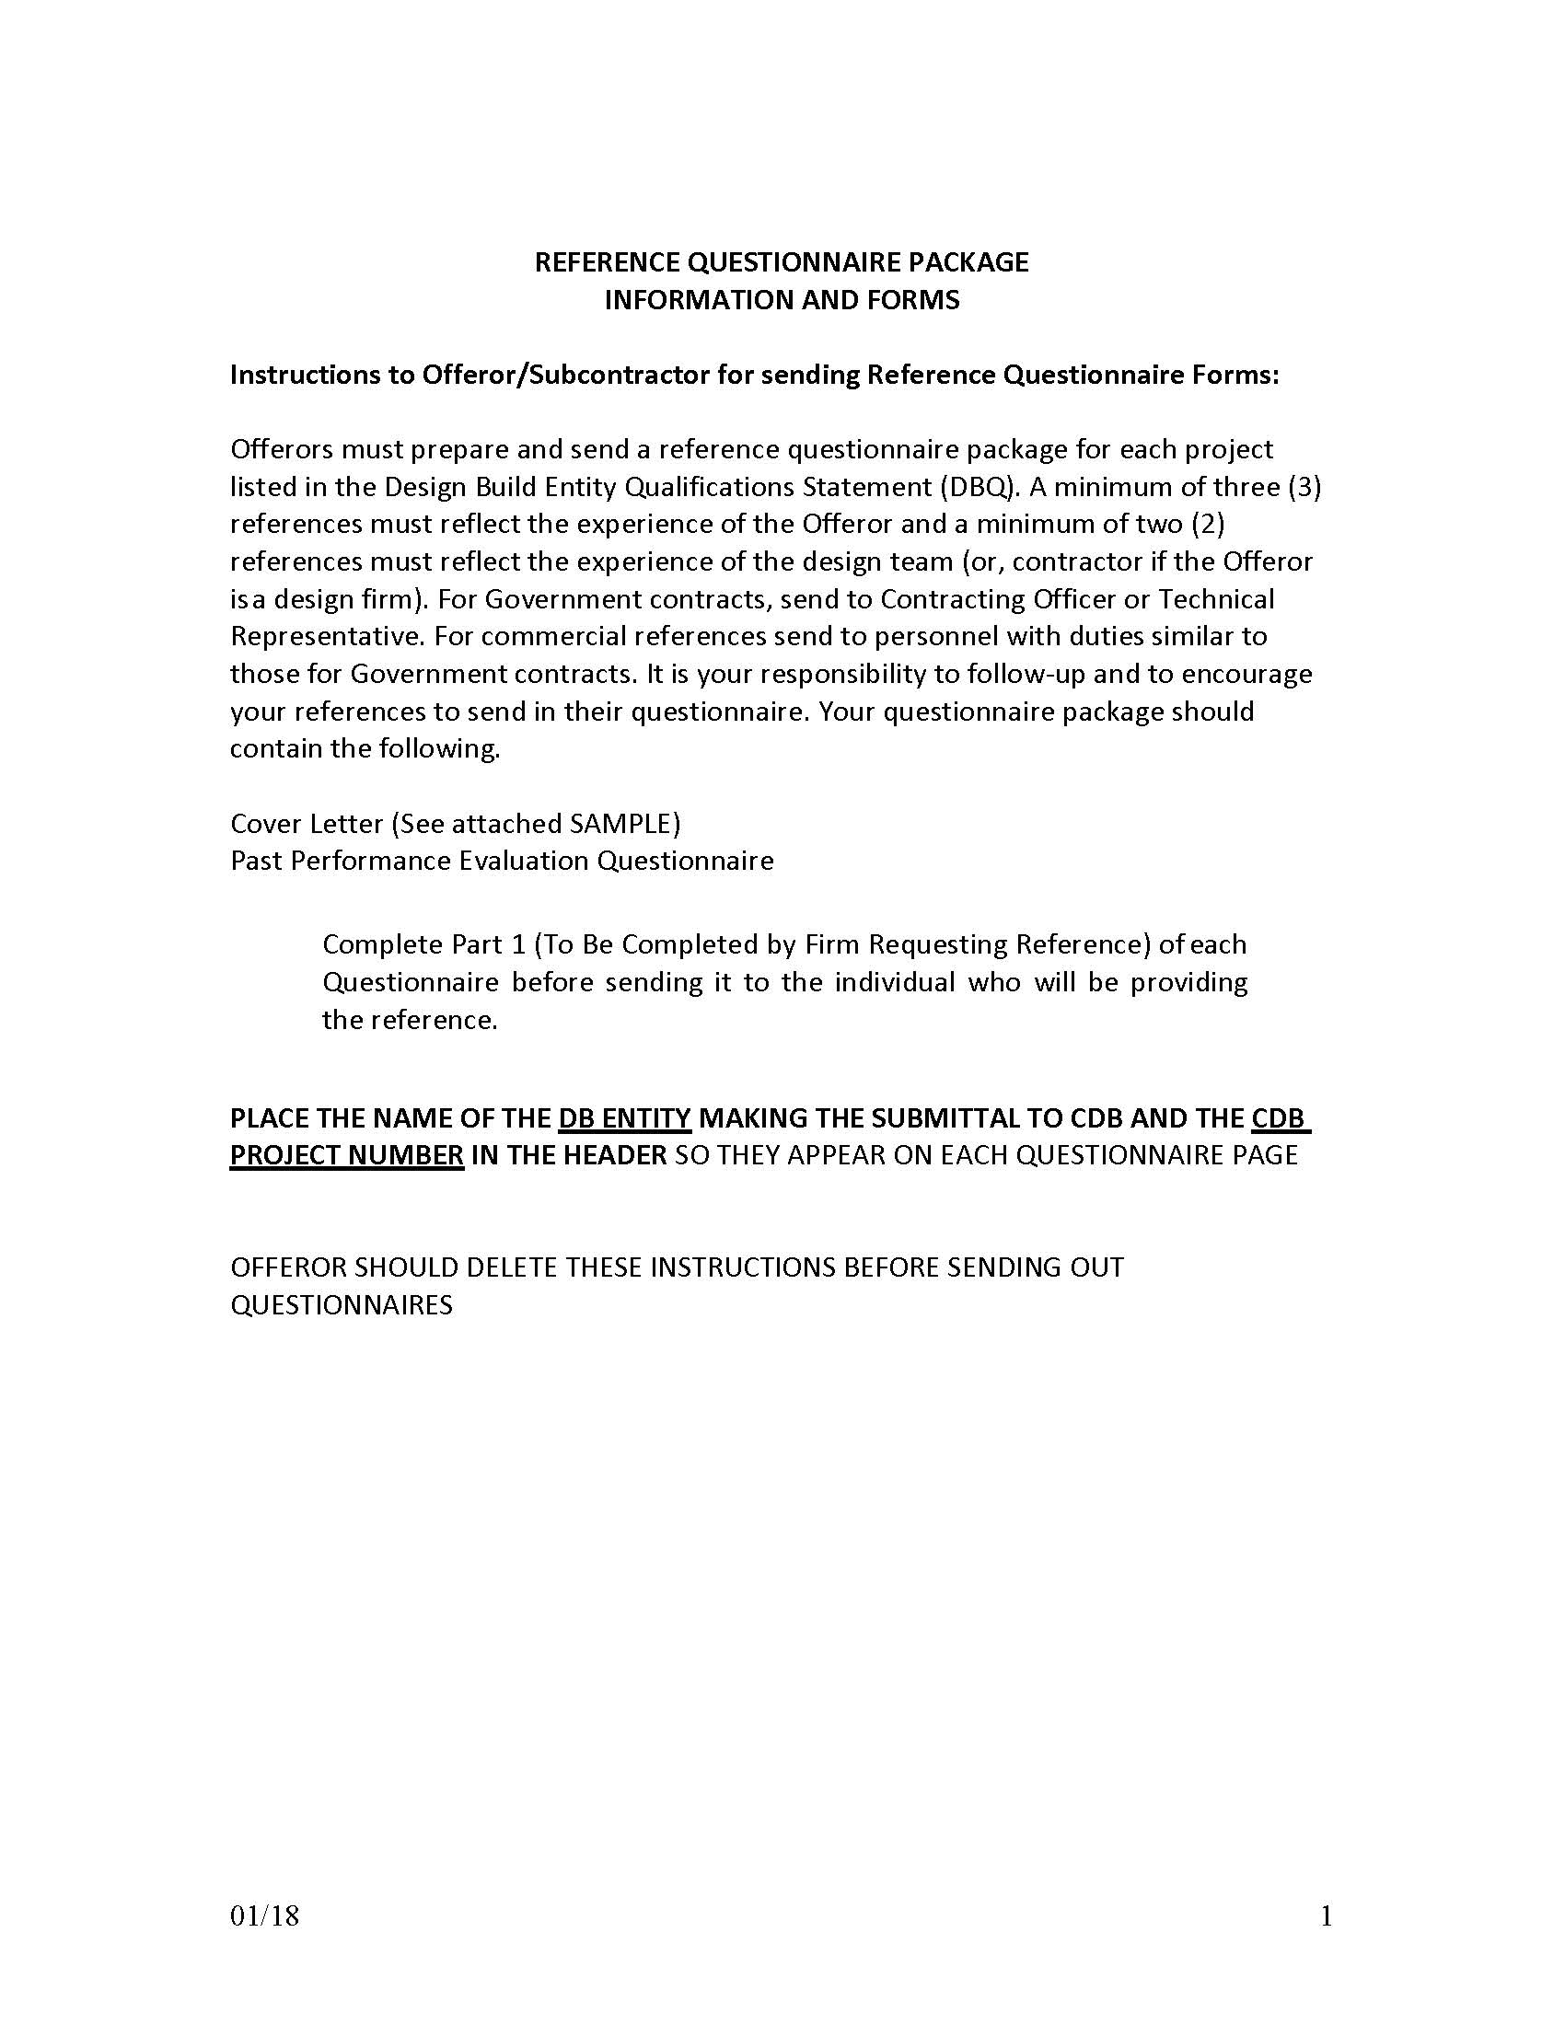
Reference Questionnaire Package

Slide 25
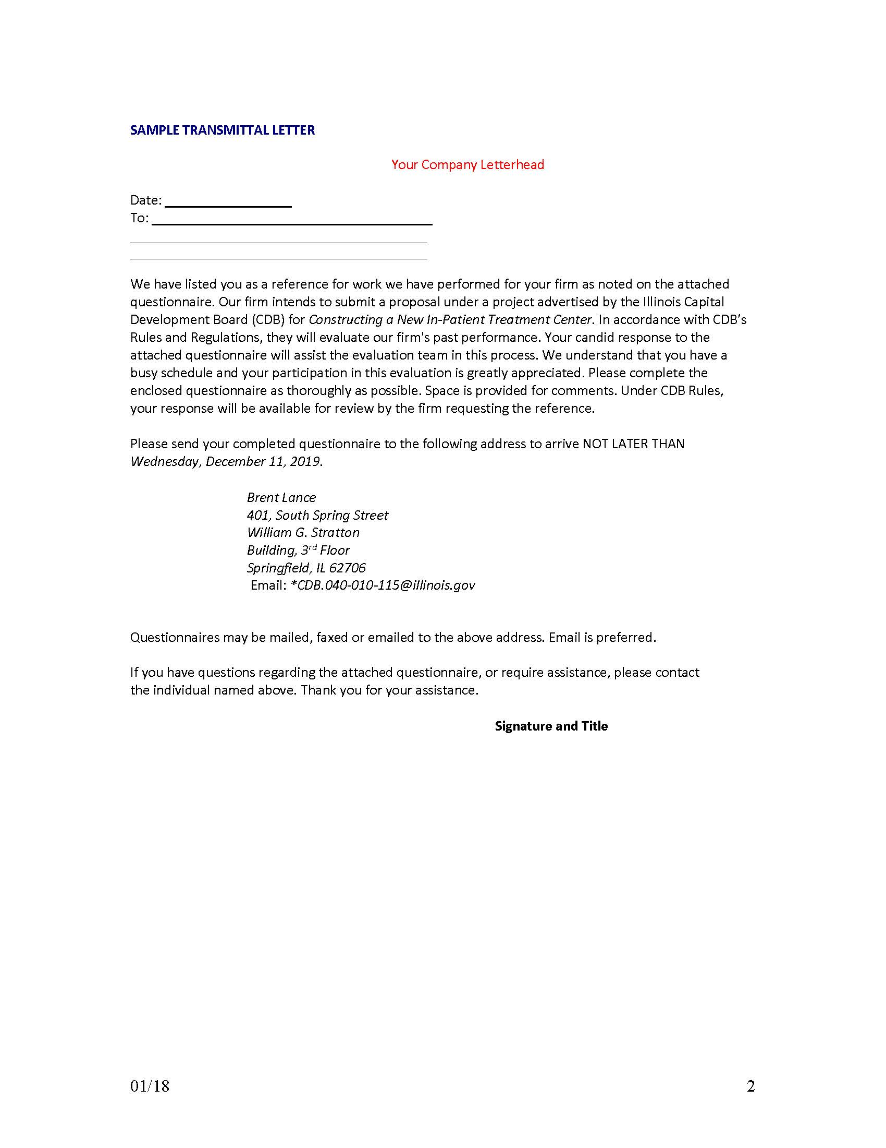
Reference Questionnaire Package

Slide 26
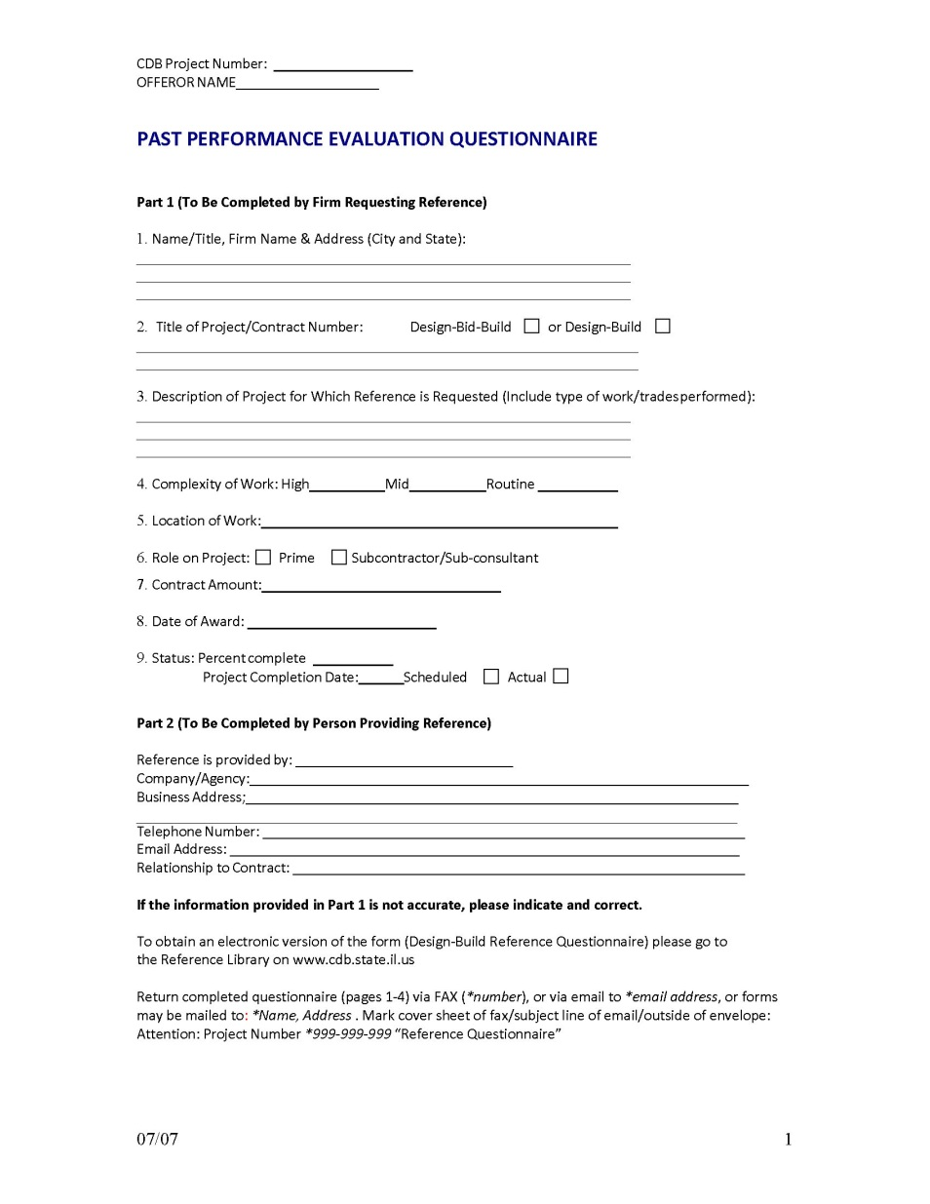
Reference Questionnaire Package

Slide 27
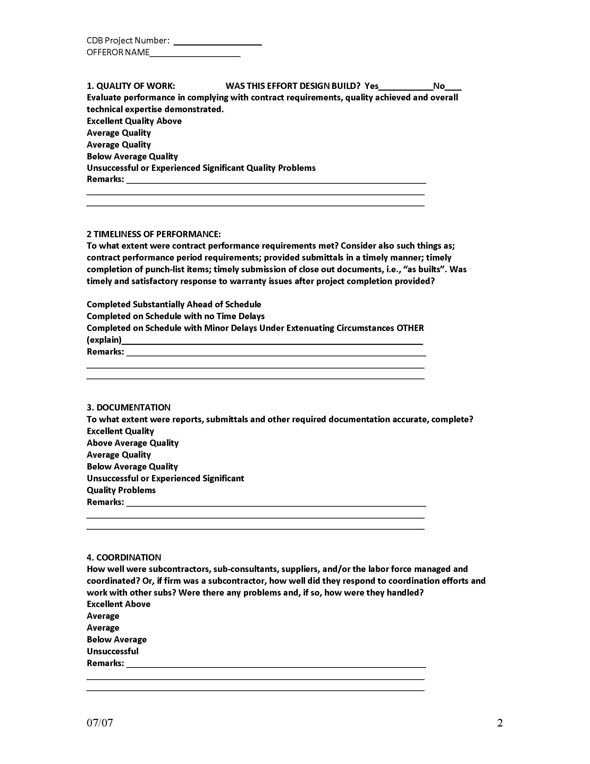
Reference Questionnaire Package

Slide 28
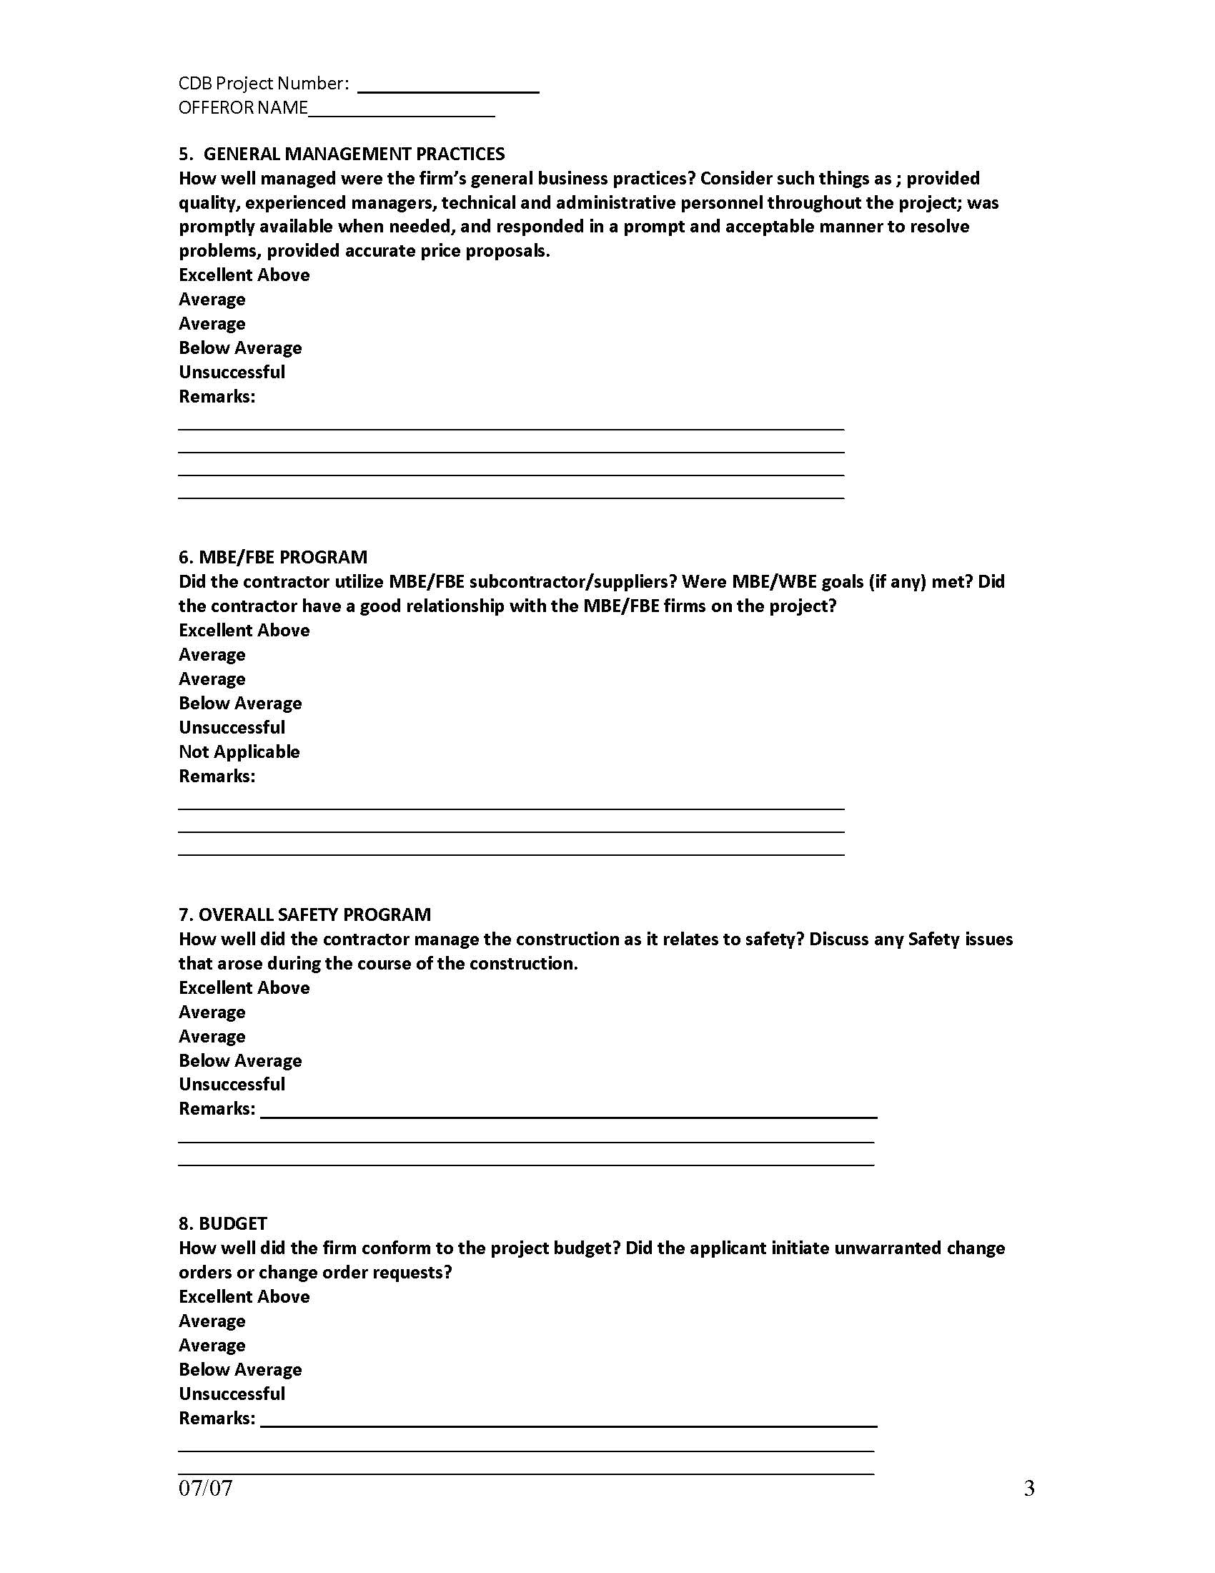
Reference Questionnaire Package

Slide 29
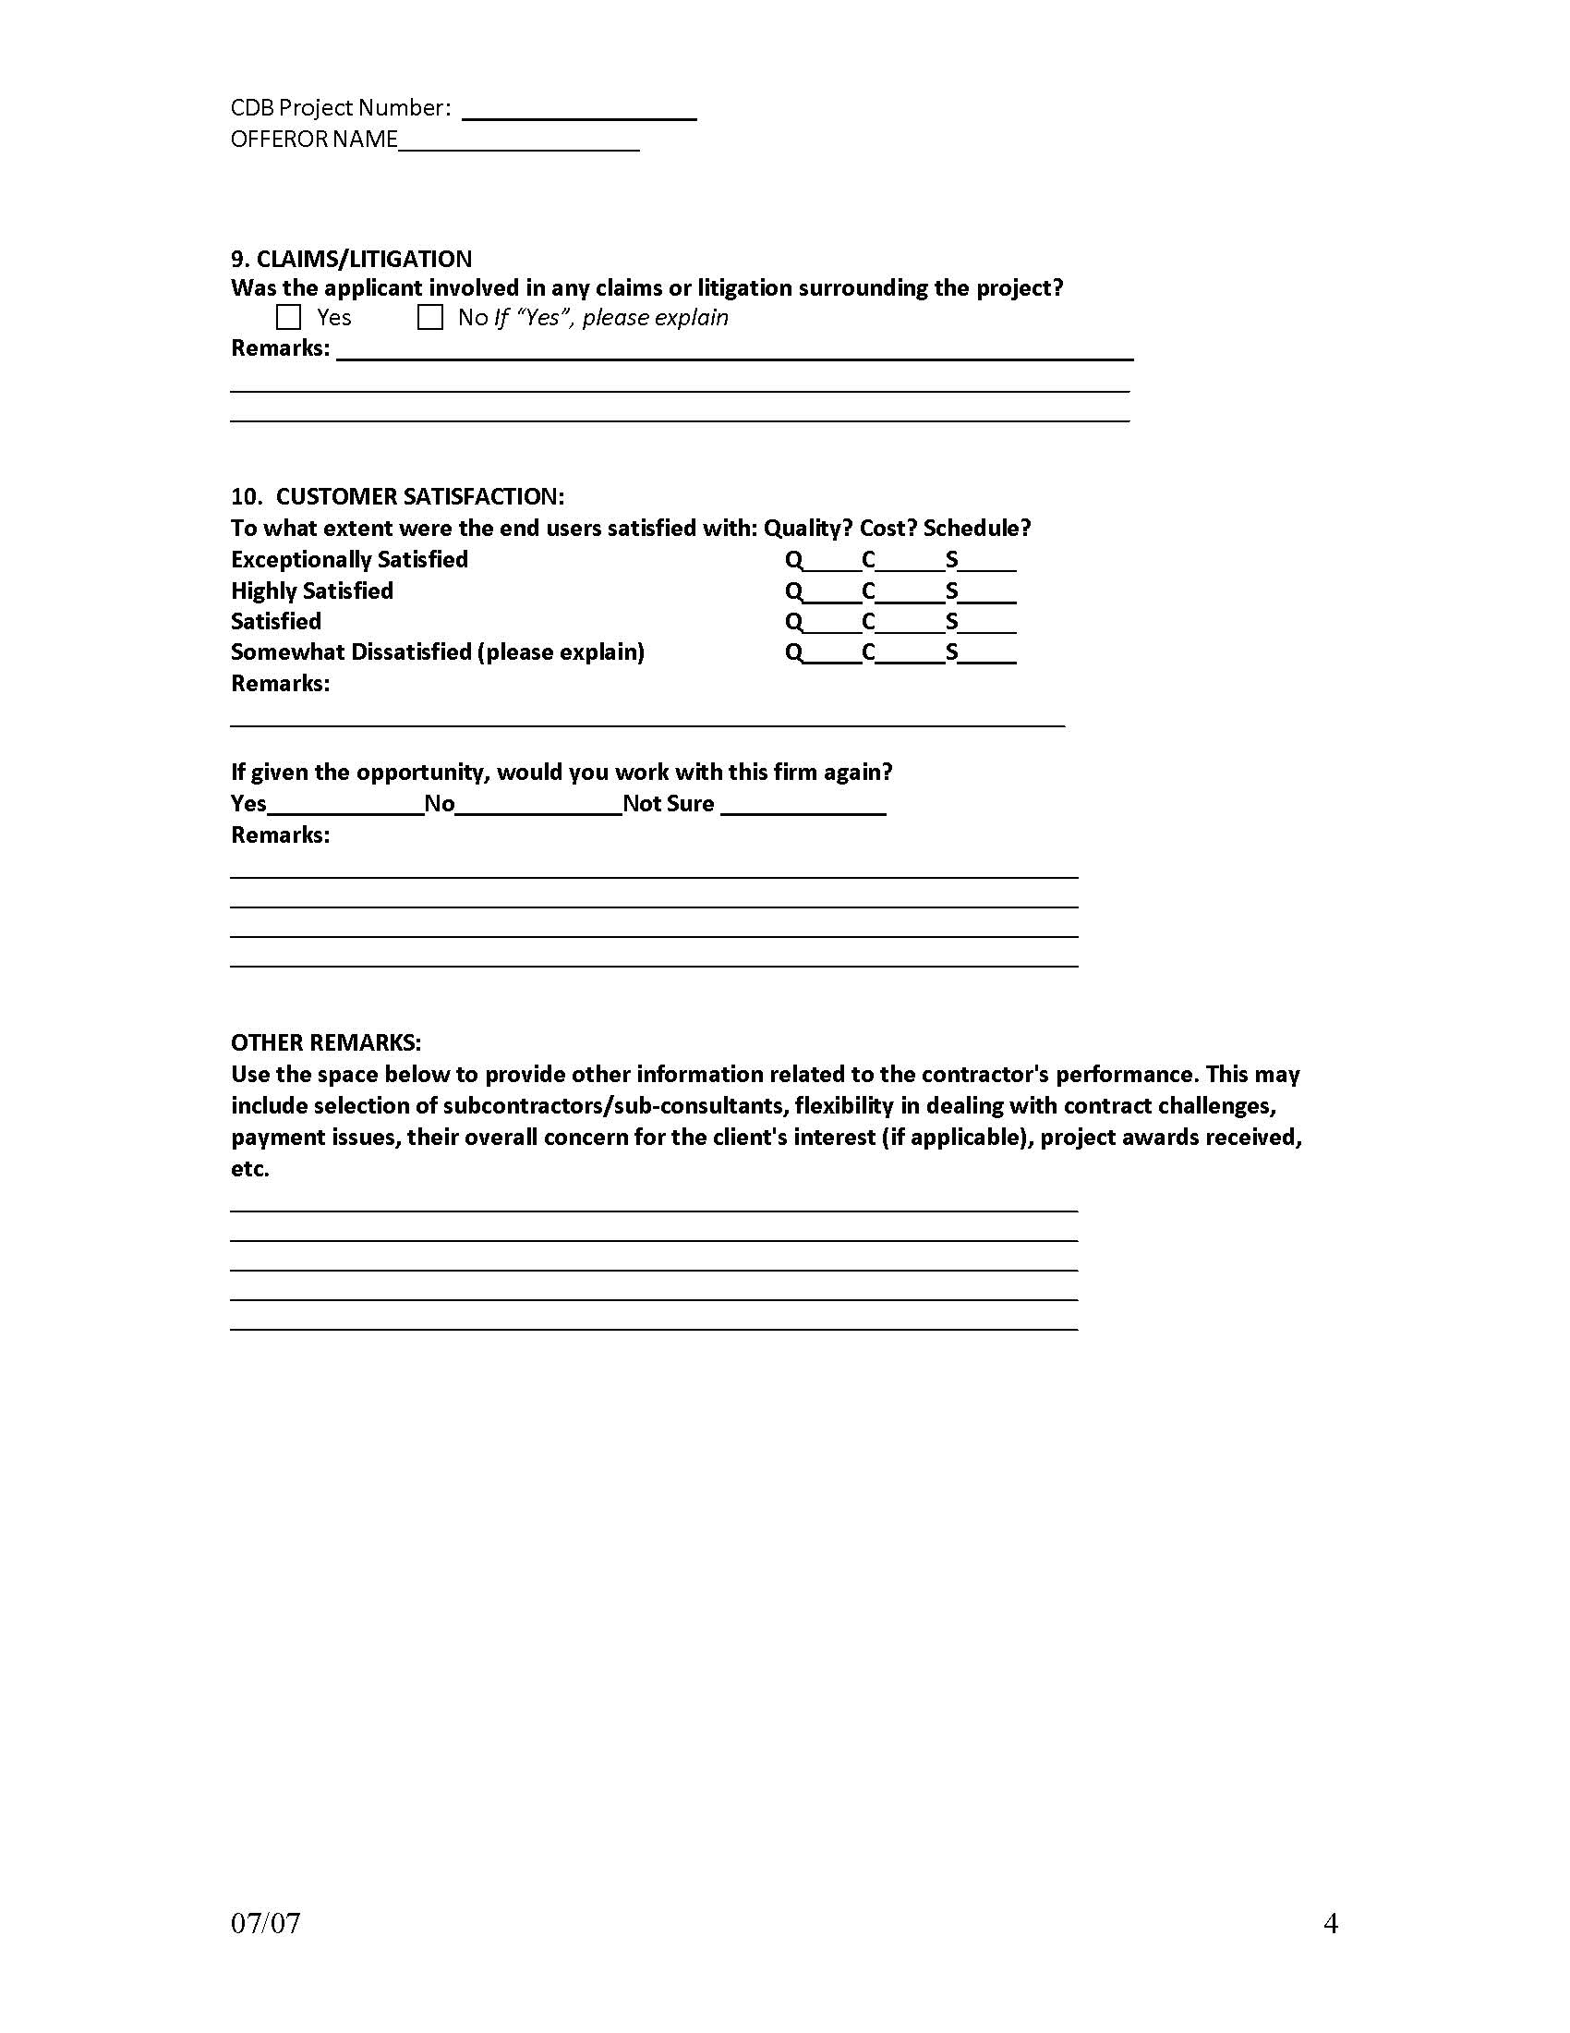
Reference Questionnaire Package

Slide 30
Reference Questionnaire Package
Failure to submit a minimum of five (5) and a maximum of seven (7) performance questionnaires is a Material Deficiency.

Slide 31
Phase I
Technical Approach Narrative
Offeror’s Team Experience
Other Capabilities
Section 3 – Technical Capability

Slide 32
Technical Approach Narrative
Maximum of 5 pages.
“Fast Track” construction
Discuss proposed organization and roles/responsibilities of all parties.
Proposed process for handling field problems.

Slide 33
Offeror’s Team Experience
Maximum of 5 pages.
Example Projects no more than 10 years old.
Information from Section 2 - Past Performance may be considered
See detailed requirements outlined on Pages 11 & 12 of the RFP.
Discuss MBE/WBE/VBE programs, goals, strategy.

Slide 34
Other Capabilities
Maximum of 2 pages.
Describe office capabilities for using BIM and other forms of technology.
Describe capabilities for scheduling along with software used and experience of staff. (A sample schedule is not desired.)
Describe your office capabilities for ensuring proper administration of a project of this size and complexity.

Slide 35
Phase I
Bonding
Insurance
Bank References
Section 4 – Financial Capability

Slide 36
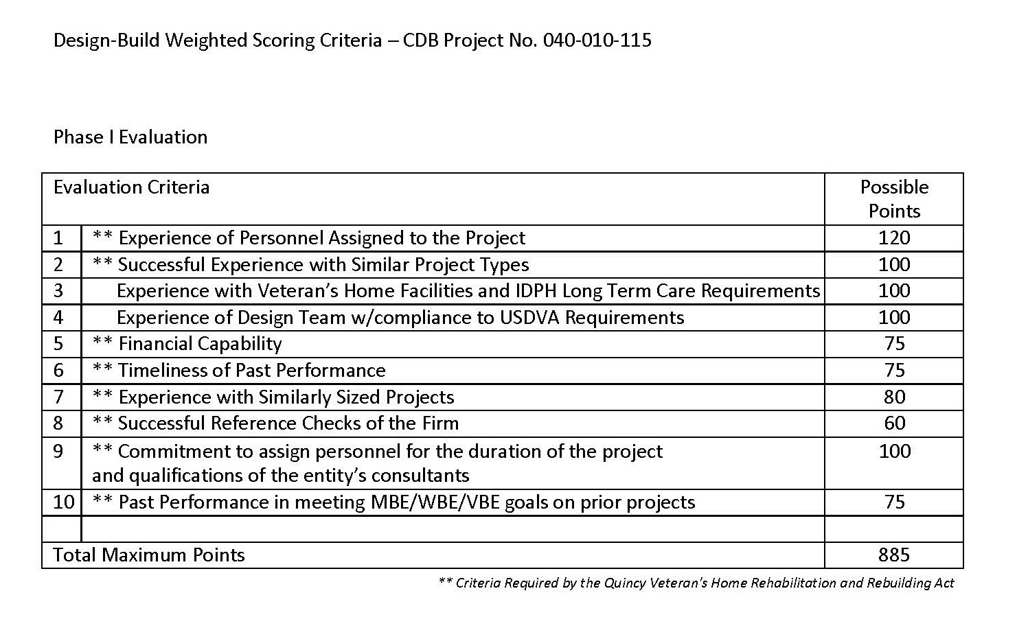
Phase I
Evaluation Criteria

Slide 37
Construct New Nursing Home and Domiciliary
CDB Project No. 040-010-115
November 19, 2019
Questions?

Slide 38
Construct New Nursing Home and Domiciliary
CDB Project No. 040-010-115
November 19, 2019
Thank you.

